Slide 1

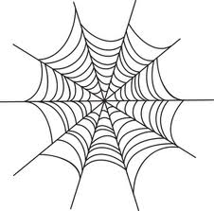












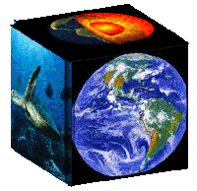


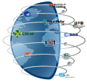


The geo Model web
Stefano nativi, paolo mazzetti, gary geller
CNR-IIA ESSI-lab, NASA JPL
July 2012
stefano.nativi@cnr.it

Slide 2
What if…
?
How will CC affect infection rate
of dengue fever in Vietnam?
?
Socioeconomic
Fossil Fuel Use Model
Data
Global Climate
Model
Regional
Climate Model
Observational Data
(environment &
vector distribution)
Data
Data
Data
Deforestation/
Disturbance Model
Vector Niche
Model
Infection
Rate Model
Data
Human Population Density
and Distribution Model
Infection Rates

Slide 3
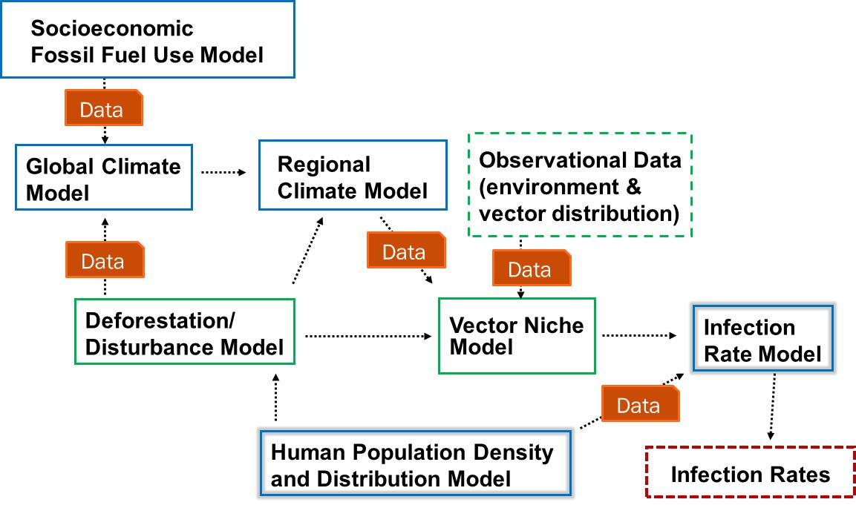

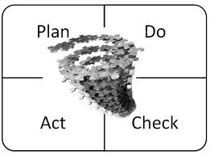
Elements …
?
How will CC affect infection rate
of dengue fever in Vietnam?
?
Business Process
Data
Model
Link/Interface
Vocabularies
Knowledge Base

Slide 4
A cyberinfrastructure …
Resources
Actions
Data
  O&M Data
  O&M Data Collections
Services (interface/link)
Models
Business Processes
Vocabularies/thesauri
Knowledge bases
Discovery
Evaluate
Access
Use

Slide 5
Models accessIbility and interoperability: An evolutionary process
Accessibility & Interoperability
dedicated tools
technological framework
CBA, SOA
Model Web
(MaaS)
CBA: Component-Based Architecture
SOA: Service-Oriented Software
Time/technology

Slide 6
Existing tools
Tools to run simulations (e.g. OpenModeller)
    Benefit: facilitate designs that are targeted to specific communities
    Concern: can be difficult to integrate the tools into more complex scenarios
An evolution of this approach is represented by nanoFORGE/nanoHub
    offers a variety of simulation tools that users can access from web browser without installing software

Slide 7
Existing frameworks
Design and adopt frameworks (e.g. Object Modelling System, ModCom, the Invisible Modelling Environment, the Open Modelling Interface: OpenMI, the Spatial Modelling Environment: SME, Tarsier, Interactive Component Modelling System: ICMS, Earth System Modeling Framework: ESMF, SEAMLESS-IF , ….)
    Benefit: provide valuable functionality
    Concern: impose constraints on model developers and integrators, such as requiring a specific programming language or development/deployment platform
The adoption of Component-Based Architectures (CBAs), and SOA solutions help to overcome some obstacles in the interoperability

Slide 8
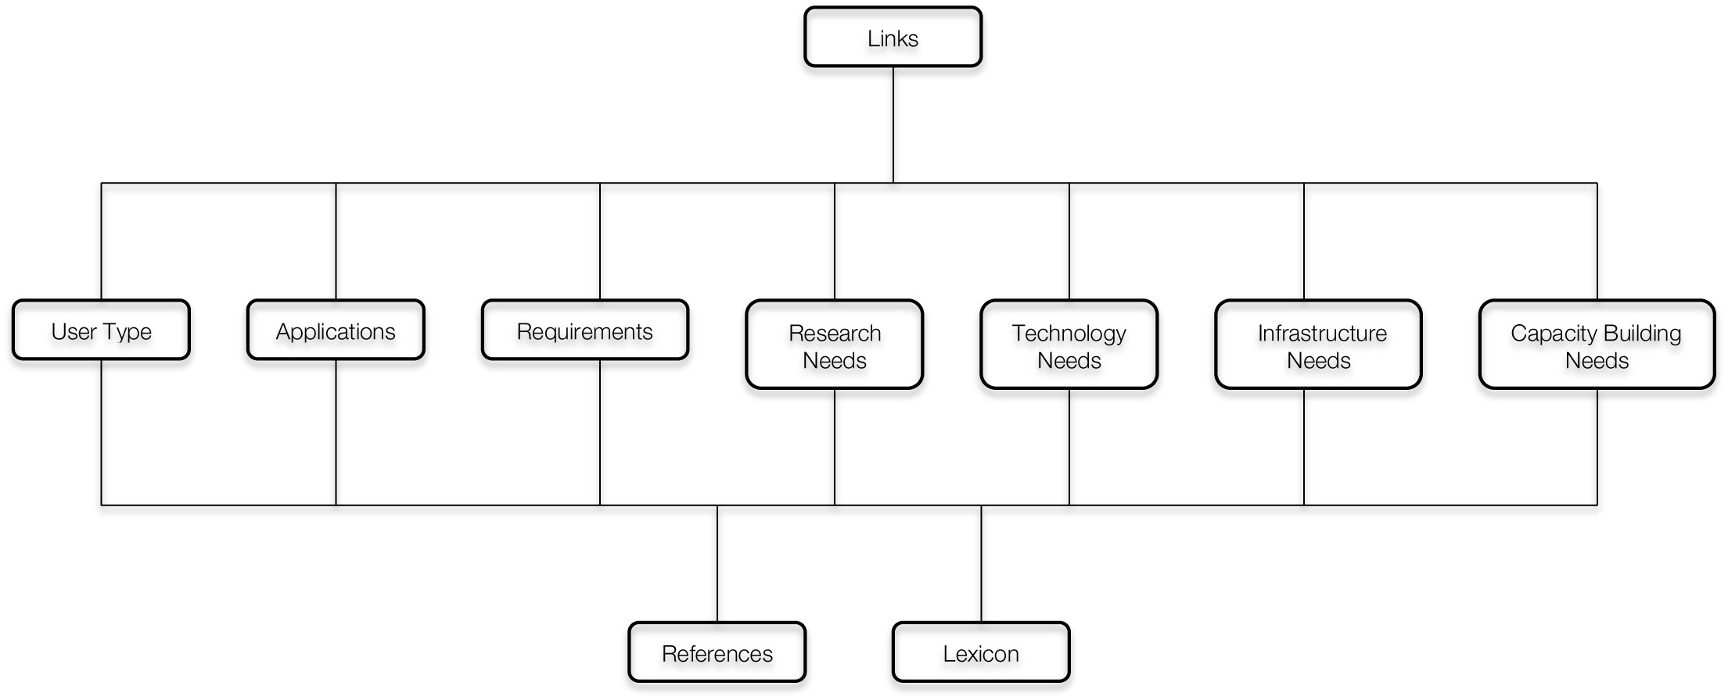

Knowledge bases
URR is a knowledge base
    Application = BP (with User’s feedbacks)
    Lexicon = Vocabulary
Gazetteers are knowledge bases, as well (e.g. event gazetteers)

Slide 9
BP accessIbility and interoperability: An evolutionary process
Accessibility & Interoperability
dedicated tools
WF-based
framework
SOA
Model Web
(BPaaS)
Time/technology

Slide 10






General Use Case
Define and run a Business Process to answer to “What if..”
A
B
C
D
  Create or Edit an abstract BP
  Compile the abstract BP
  Execute the BP
  Return the output to the User
USER
BP editor
BP
Brokers
WF engine
Middleware
BP Libraries
Knowledge Bases

Slide 11
What is missing ..
Components
(abstract) Business Process editor
  URR platform
  Semantic Broker
Business Process broker
  BP Compiler
  Discovery Broker
  Access Broker
Business Process engine
  WF engine

Slide 12

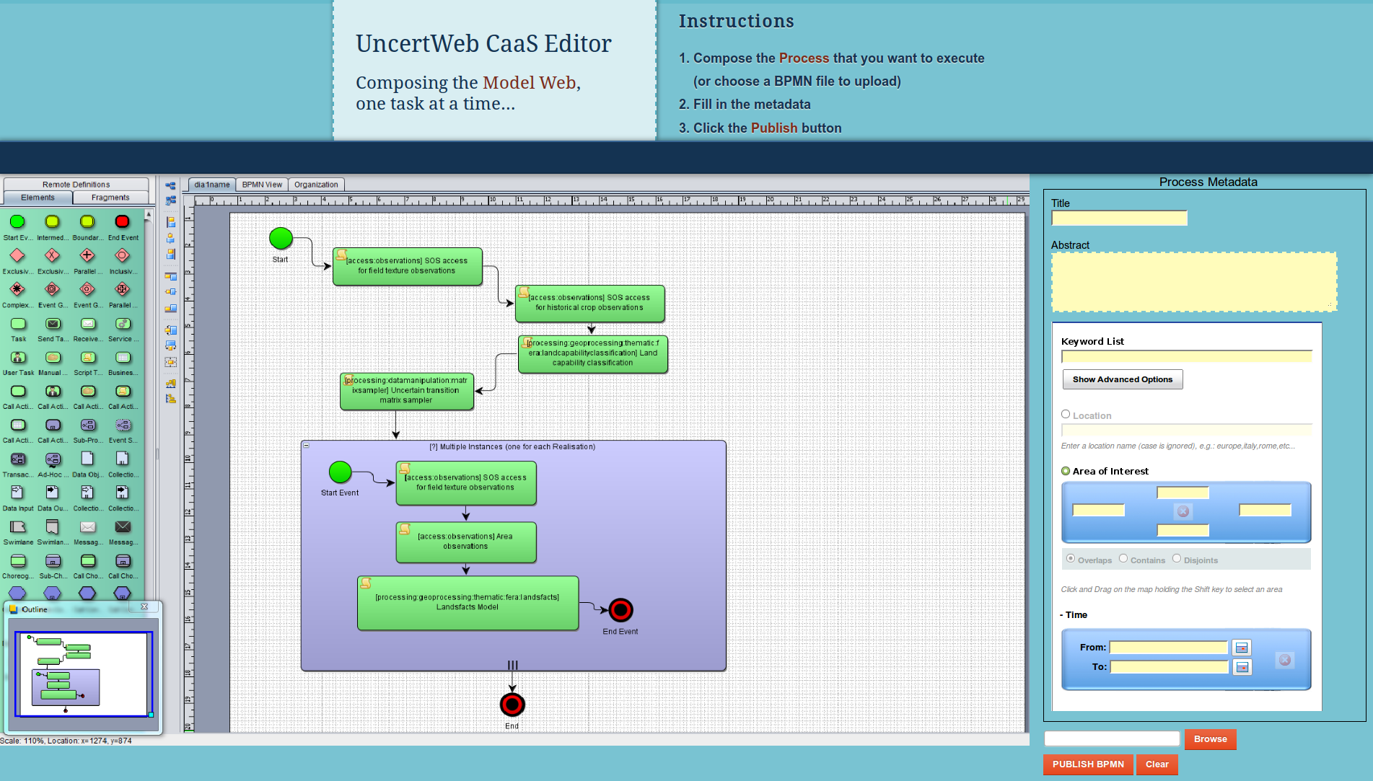



BP editor

Slide 13
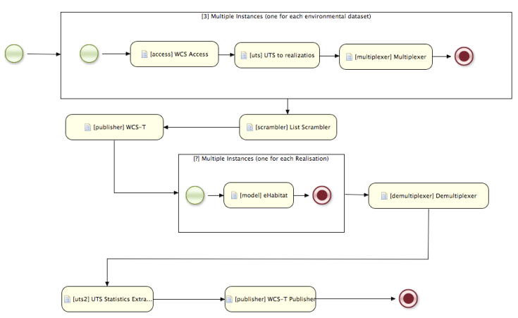
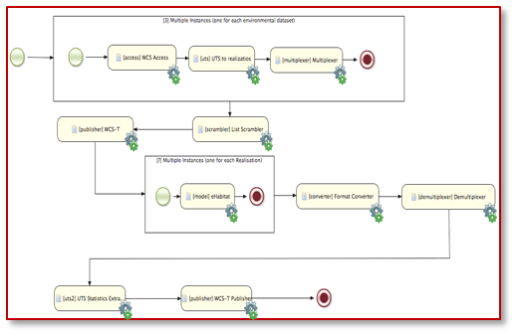
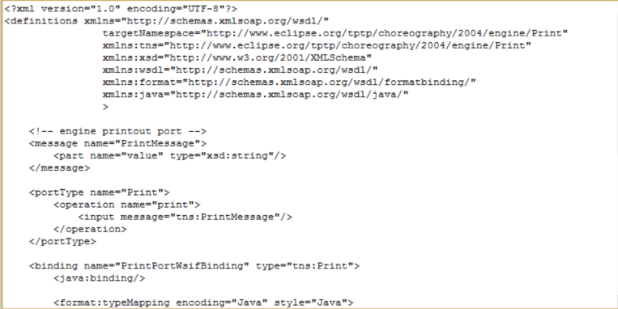

Business process compiler
A-BP
Read an abstract BP
Intermediate
BP
Pre-process the abstract BP to an Executable BP
E-BP
Identify BP input/output
Annotated

Slide 14
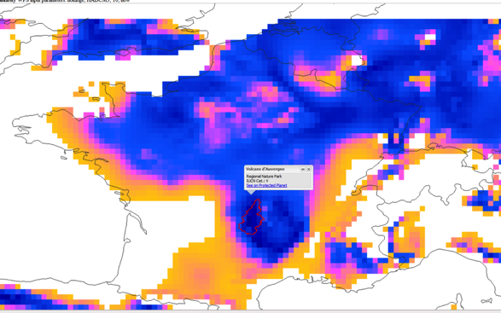

WF-Engine
E-BP
Read an E-BP
I/O
Input ingestion
Run
WF execution
Publish the outcome(s)
Outcome

Slide 15

it is not yet another WF technology
Business Process Editor
Business Process Broker
WF platform
Knowledge Base

Slide 16
BP Broker benefits
Lower User entry barrier (i.e. is an agent)
  No need of a composition infrastructure
  Alleviation from the technicalities of workflow definitions
      type matching, identification of external services endpoints, binding issues, etc.
  User can focus on his/her intended target
  User may submit incomplete BP definition, and leverage CaaS recommendations
      may derive from an aggregated knowledge base of user feedback to execute it (e.g. URR)
      Of particular interest for multidisciplinary scientific contexts, where different communities may benefit of each other knowledge through model chaining

Slide 17


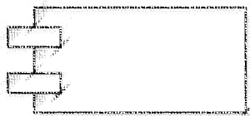

UncertWeb Bp Broker
URR
BP Editor
BP library
BP Broker
Resources
Brokering
framework
Component library
Controller
Preprocessor
WF engine

Slide 18
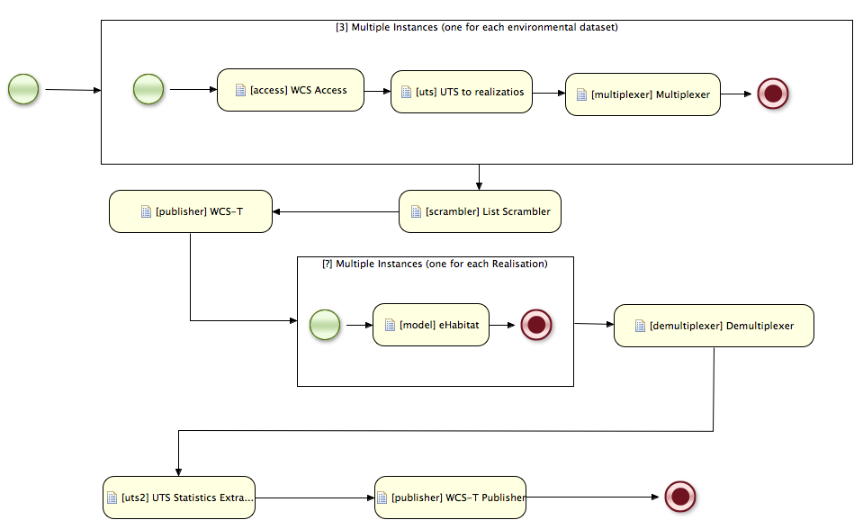

eHabitat BPMN

Slide 19
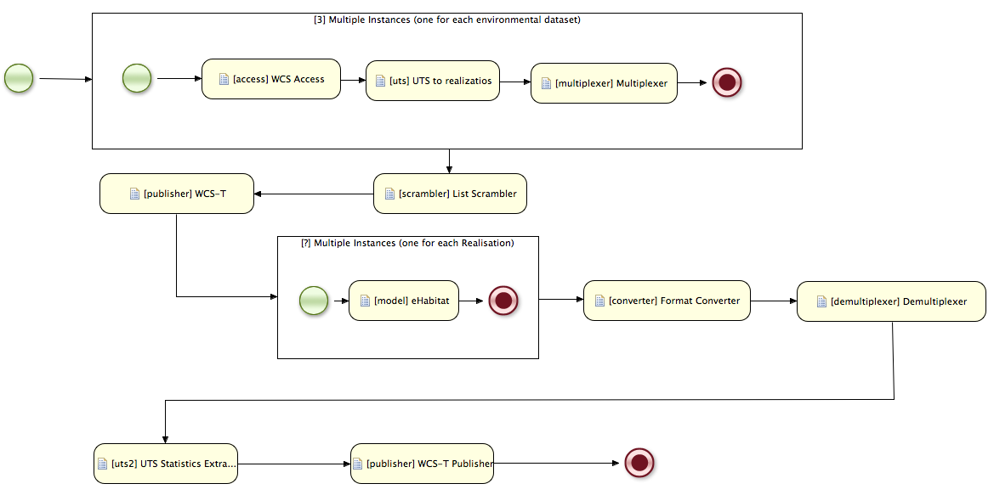

Executable eHabitat BPMN
Annotated

Slide 20

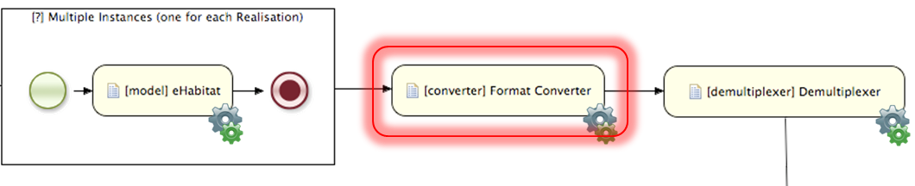
Preprocessing steps
Annotated
Components Validation
Components compatibility check
  Mismatches identification
  Mismatches resolving (through mediation/adaptation approach)
Identification of actual I/O parameters of the Executable BP
✓
✗
✓

Slide 21
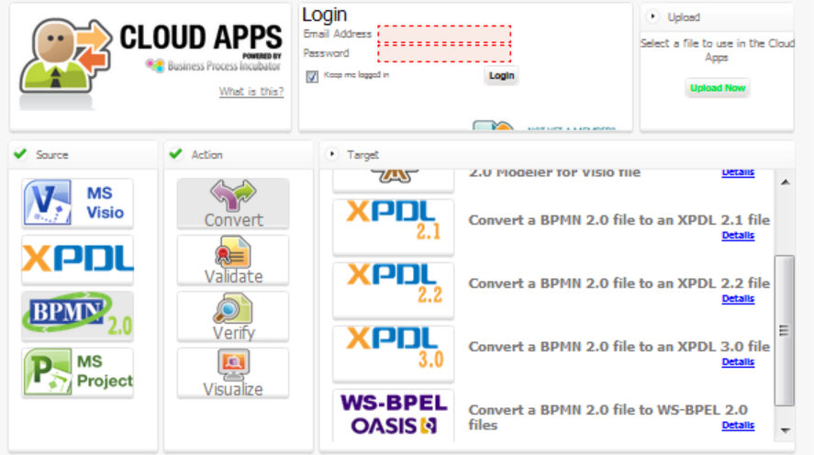
Execute the annotated BP
WF engines that can run the annotated BPMN
  jBPM engine (open-source workflow engine written in Java realized by JBOSS)
  converter(s) to run other engines (e.g. BPEL, XPDL, ..) are under investigation

Slide 22
Output

Slide 23
Some theory: Conceptual model

Slide 24

prototype
Scenario implementation
    eHabitat ✓
    FERA ✓
    NILU
    ALBATROSS
  BP Broker accessible as a WPS profile

Slide 25
Possible User Scenarios
Belmount Forum call (Norman Miller et al.)
    Freshwater Security in the Limpopo Basins: Linking Science, Policy Making, and Public in a Trans-Boundary, Climate Sensitive River Basin to Increase Resilience to Extreme Events
    Climate Vulnerability and Risks of Urban Coasts: A Best Practice for Prioritizing Adaptation

Slide 26
User Scenarios (for Citizen Science)
Objective
  Ozone production on the Mediterranean Basin
  Impact of Ships / electricity generation / road traffic / ….
  Effect on public Health
Scientific patrons
  CNR-IIA
  Harvard Univ (TBC)
  EPA (TBC)
Approach
  Play with the emission source sectors, run the model, and assess the impact on air quality parameters
  Play with the emissions of large conurbation
  Include human health datasets (e.g. asthma outbreaks spatial distribution
    Statistical analysis

Slide 27
Model web
challenges

Slide 28
Vision
A dynamic web of models, integrated with databases and websites, to form a consultative infrastructure where researchers, managers, policy makers, and the general public can go to gain insight into “what if” questions

Slide 29
Introduction
Integrating models into more complex, tightly coupled model systems has been done for decades and has led to great progress in predictive capabilities
The idea of bringing together independent models to form loosely coupled model systems has existed in various forms for some time
    technological challenges and other constraints have limited progress
The concept of model access by Web services (called “Model as a Service”: MaaS) has been around for several years
    model interfaces have been designed and tested to expose the models as web services

Slide 30
The Model Web Basic Principles
Basic principles that facilitate organic and opportunistic growth
Open access
  anybody can create a service to share their model and anybody (or any machine) can access it
Minimal barriers to entry
  minimize the entry barriers of both resource providers and users
Interface-driven approach
  Model access is provided by an Interface (service or resource based)
Scalability
  Distributed approach

Slide 31
The Model Web architecture
Distributed system
  Resources distribution
System of Systems
  Organic Growth
  No Single Point of Failure;
  Interoperability Arrangements;
  Systems autonomy.
WWW
  Scalability;
  Low entry barrier;
  Organic Growth.
Semantic Web
  Reasoning;
  Conceptual Composability.
Web 2.0
  Low entry barrier:
  user-centered design;
  collaboration on the WWW
Abstract
Implementation

Slide 32
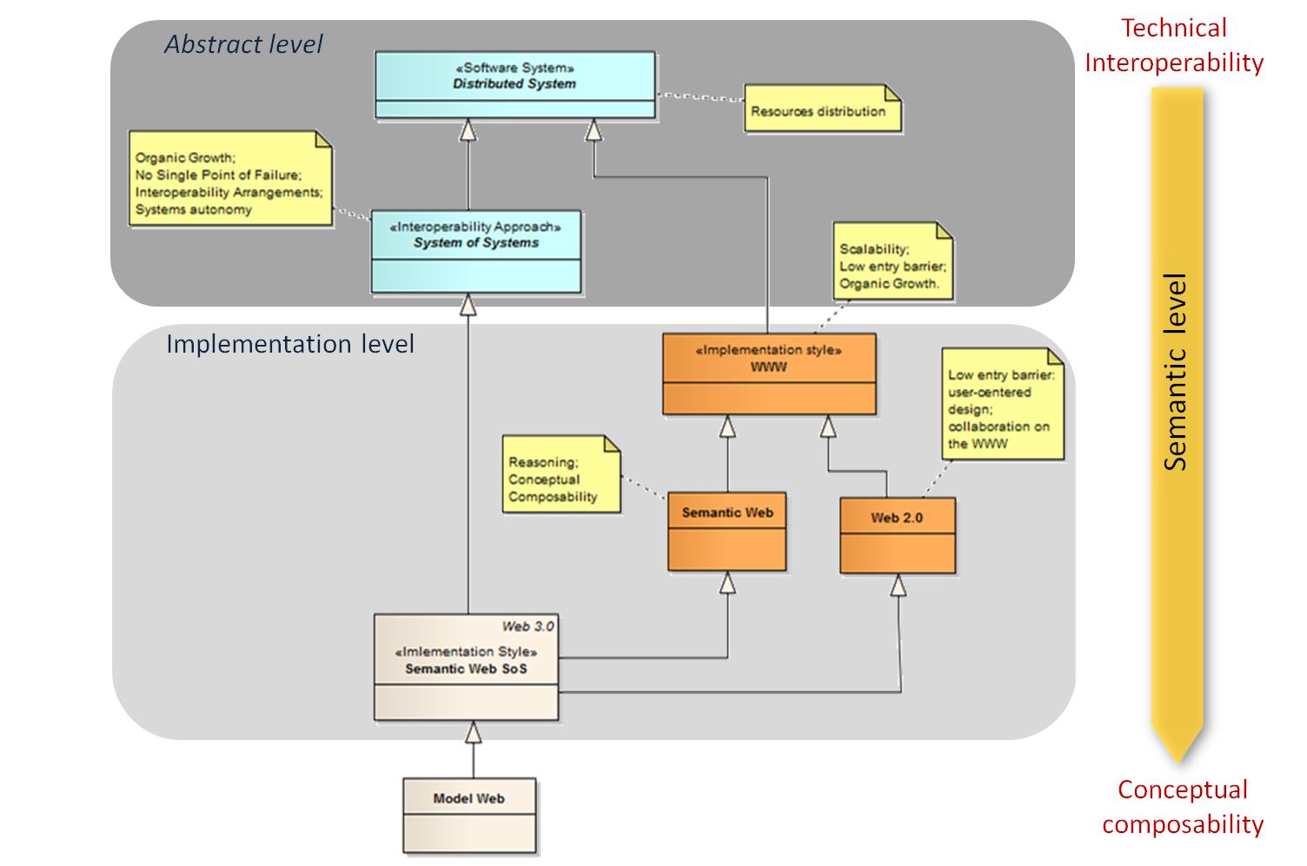
The Model Web Architectural Context
Is a
Semantic Web
System of Systems

Slide 33
Challenges
Non-technical challenges
Model-Related challenges
Cultural, and Social, challenges
Technical challenges
Information modelling
Minimal interoperability agreement
High performance
Long-term access
Organizational and Institutional challenges

Slide 34
Information Modelling: the Context
A view of all the objects and concepts
Tech

Slide 35
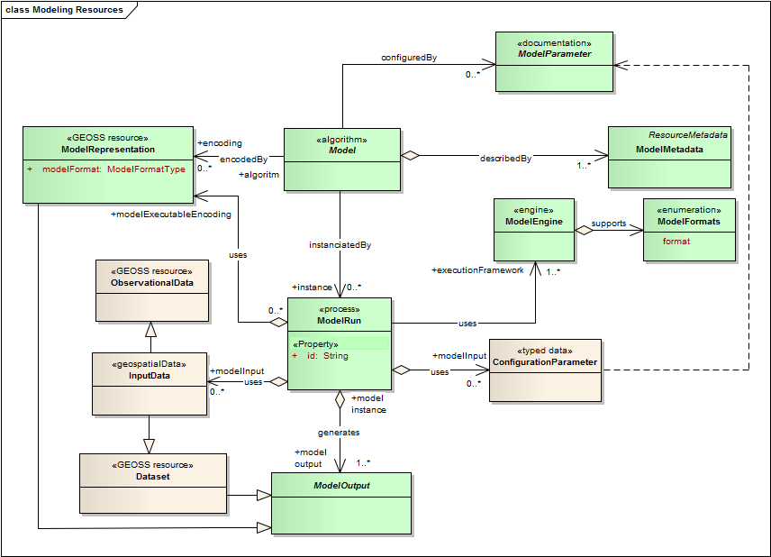

The Environmental
Model Resources
Tech

Slide 36
The Metadata types
Tech

Slide 37





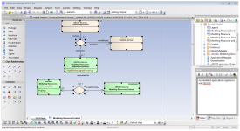
Minimal Interoperability Agreements
Tech
Adopt the Brokering principles to implement a System of Systems
Provides the necessary intermediary services (Brokers) to solve mismatches
Knowledge
Base
Data resources
Modeling resources
Brokering services
Tools/Applications

Slide 38
High Performance Challenge
Tech
Environmental model workflows may require a great amount of computing power and storage space
Scalability is important
To leverage existing solutions and systems proposed for High Throughput Computing (HTC) and High Performance Computing (HPC)
Stand-alone systems
    super-computers, clusters, General Purpose Graphical Processing Units
Distributed Computing Infrastructures (DCIs)
    Grids and Clouds

Slide 39
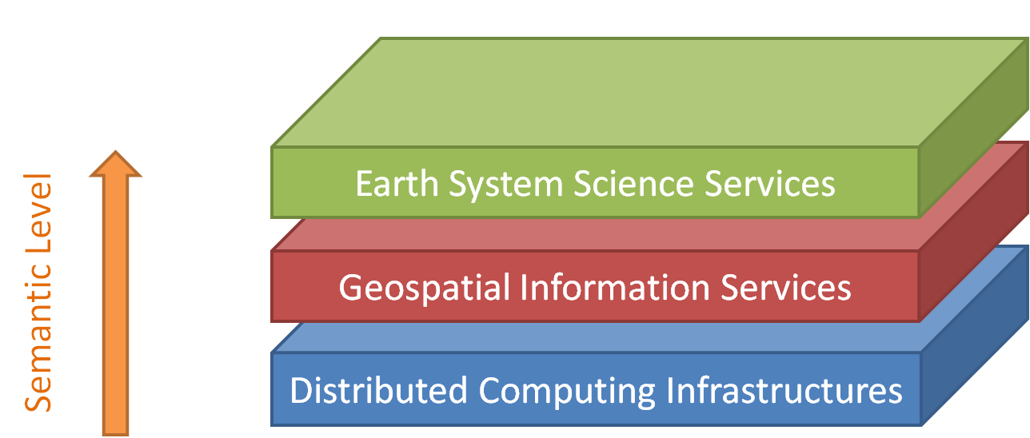
High Performance Challenge
Tech
Model and model workflows cannot be simply “ported” on top of a DCI
in a Model Web view, a DCI should be integrated as one of the many autonomous systems (according to the System-of-Systems principle)
Model must be accessed through specific services implemented on top of the DCI

Slide 40
Long Term Access Challenge
Tech
To new approaches are applicable to the Model
Web
  Standardization is a means for addressing interoperability by reducing the heterogeneity
    Metadata specifications ( see ModelMetadata) may include preservation information according to existing standards like the Open Archival Information System (OAIS).
  Virtualization is an emulation approach
    virtual hardware/software platform runs on a different hardware/software platform through a virtual machine
    virtualization is an important trend in current IT, and is at the basis of Cloud Computing.

Slide 41
GEO GEOSS
The Model Web concept is being developed within the framework of GEO (Group on Earth Observations) and GEOSS (Global Earth Observation System of Systems; GEOSS, 2005)
It is a specific task led by NASA, IEEE, the European Commission (EC), and the National Research Council of Italy (CNR)

Slide 42
On-Going development
Model Web growth is still in the early stages
However there are already some significant activities
  GEO pilots (e.g. CC impact on Biodiversity and ecosystem changes; ecosystem uniqueness analysis, etc.)
  FP7 projects (e.g. Brokering framework; uncertainty propagation for resources chaining; MaaS development, CaaS development, etc.)
  NASA programs (e.g. NEX provides virtual modelling resources, including supercomputer access; accessibility to Terrestrial Observation and Prediction System: TOPS and Regional Ocean Modeling System: ROMS, etc.)

Slide 43
Thank you !
Questions ?

