Slide 1
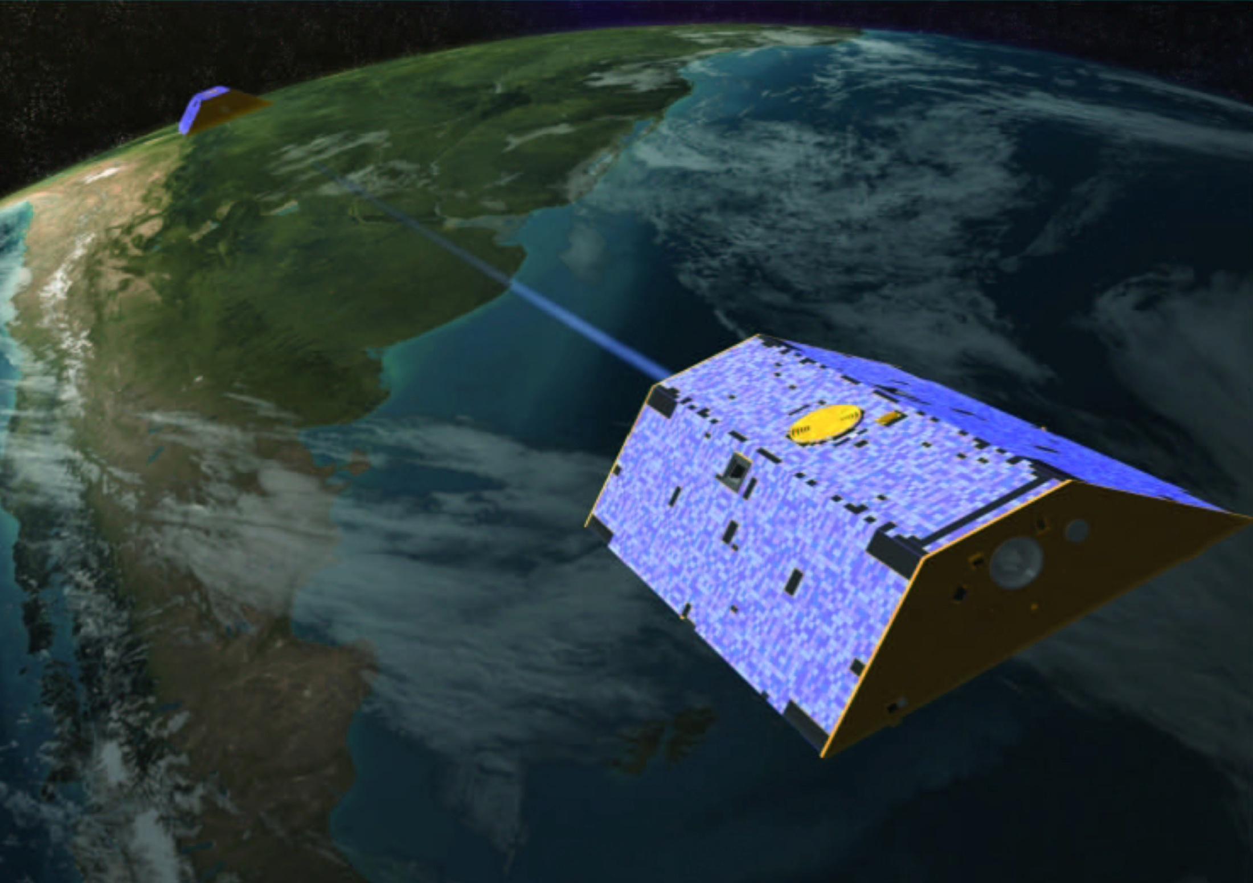
Applications of the GRACE Data Assimilation System for Regional Groundwater Monitoring
Ben Zaitchik, Matt Rodell, Rolf Reichle,
Rasmus Houborg, Bailing Li,
John Bolten, Bart Forman

Slide 2
Outline
Motivation for GRACE-DA
Methodology & Proof of Concept
New Applications
  Europe
  North America
  Middle East / North Africa
  Nile River Basin
Future Directions

Slide 3
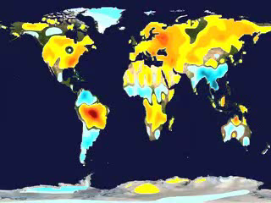
Motivation
Limited Resolution:
Horizontal ≈ 160,000 km²
Vertical = None
Temporal = 10 day to Monthly
GRACE
Unprecedented observations of total water storage
Highly relevant to the water cycle and water resources
A constraint on the basin-scale water balance
Data Assimilation:
NASA Catchment
Land Surface Model

Slide 4
Definition of LDAS
A Land Data Assimilation System (LDAS) is a computational tool that merges observations with numerical models to produce optimal estimates of land surface states and fluxes.

Slide 5
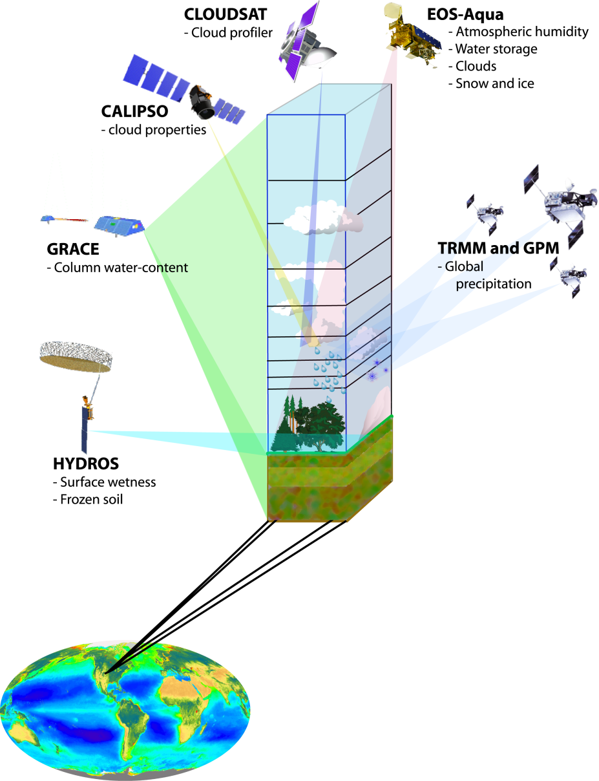
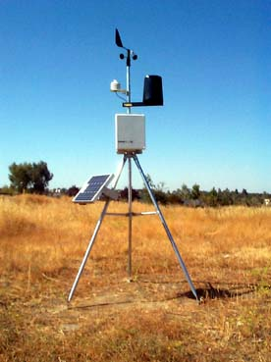
Definition of LDAS
A Land Data Assimilation System (LDAS) is a computational tool that merges observations with numerical models to produce optimal estimates of land surface states and fluxes.
+
Distributed
Global
Precise
Complementary
–
Instantaneous
Short data record
Incomplete
Limited Resolution
–
Point location
Limited coverage
Non-uniform
+
Reliable
Continuous
Affordable

Slide 6
Definition of LDAS
A Land Data Assimilation System (LDAS) is a computational tool that merges observations with numerical models to produce optimal estimates of land surface states and fluxes.
+
Complete
Physically-based
Sophisticated
Flexible
–
Require inputs
Can be wrong

Slide 7
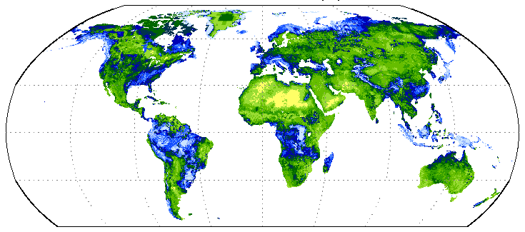
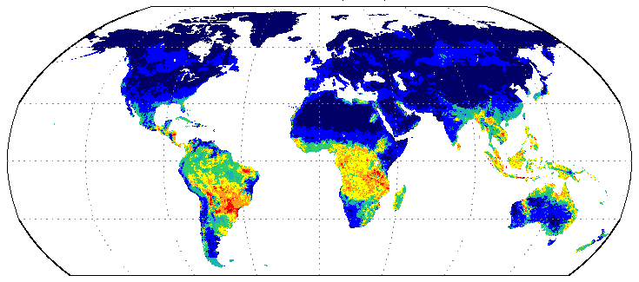
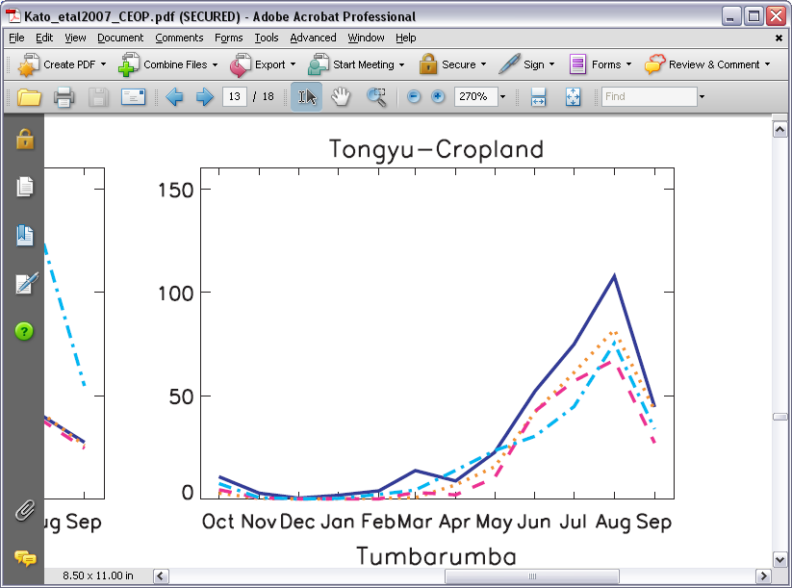
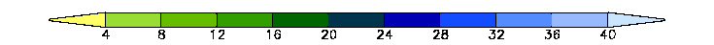
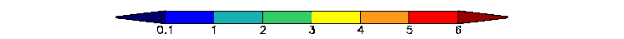
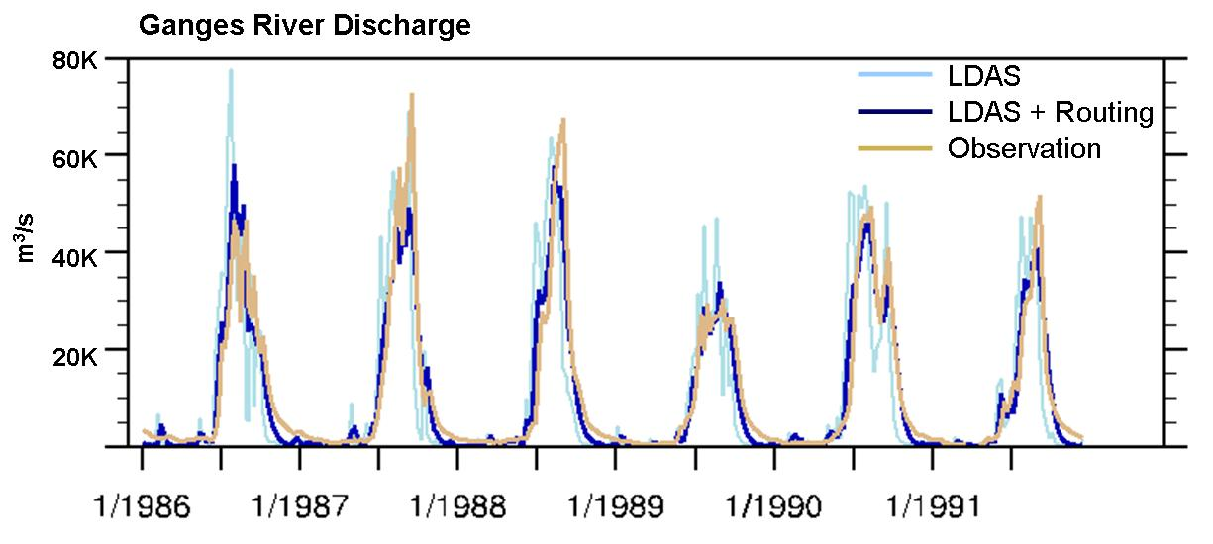
Definition of LDAS
A Land Data Assimilation System (LDAS) is a computational tool that merges observations with numerical models to produce optimal estimates of land surface states and fluxes.
EVAPOTRANSPIRATION
SOIL MOISTURE
EVAPOTRANSPIRATION

Slide 8
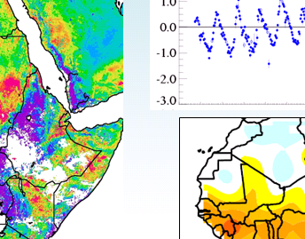
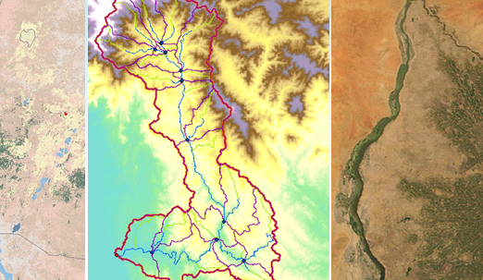
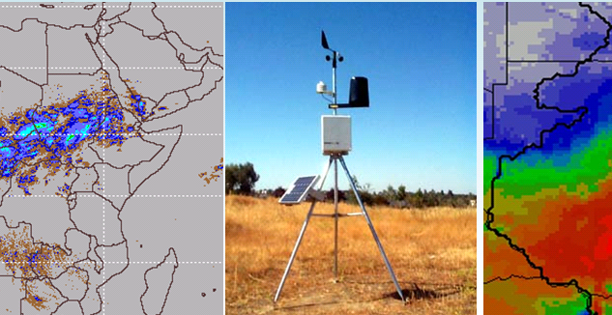
LDAS Input and Output
Update Observations
Landscape Information
LDAS Output
Numerical Model
Climate Data

Slide 9
Model: Catchment LSM
three snow layers
surface excess
root zone excess
“catchment deficit”
z
% saturated

Slide 10
Update Method: Ensemble Kalman Smoother
1
State space: catchment scale
2
Observation space: basin scale, monthly average
5th
15th
25th
Tile 1
TWS
Model storage term
Tile 2
GRACE_{TWS} ( )
X
T
−
Jan 1
Feb 1
3
5
4
5th
15th
25th
Tile 1
Model storage term
Tile 2
Jan 1
Feb 1
Mar 1
Zaitchik et al. (2008)

Slide 11
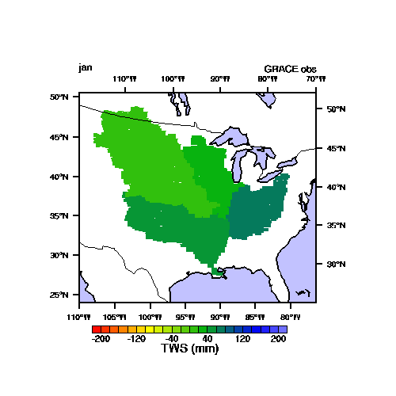
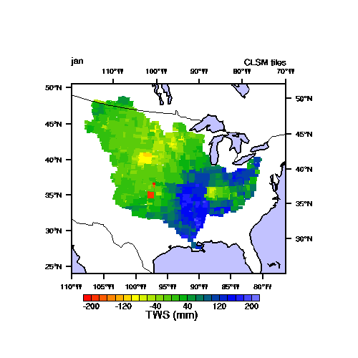
First Application: The Mississippi
GRACE TWS’: 2005
Assimilation TWS’: 2005

Slide 12
First Application: The Mississippi
Open Loop
Assimilation

Slide 13
First Application: The Mississippi
GRACE-DA significantly improved simulation of seasonal and inter-annual groundwater variability at sub-basin scale
At watershed scale, simulation of groundwater and discharge was improved in some cases.
Results for fluxes were promising, but require further study
Zaitchik , Rodell, and Riechle (2008), Journal of Hydrometeorology

Slide 14
Extending GRACE-DA
How does the system perform in other climate zones?
What is its operational potential?
What potential does GRACE-DA hold for data poor regions?

Slide 15
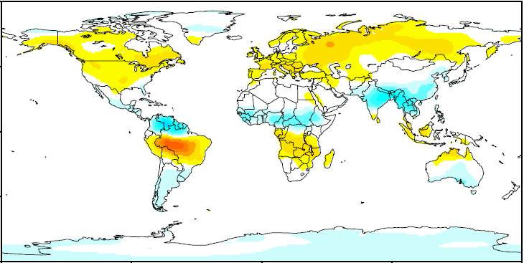
Extending GRACE-DA

Slide 16
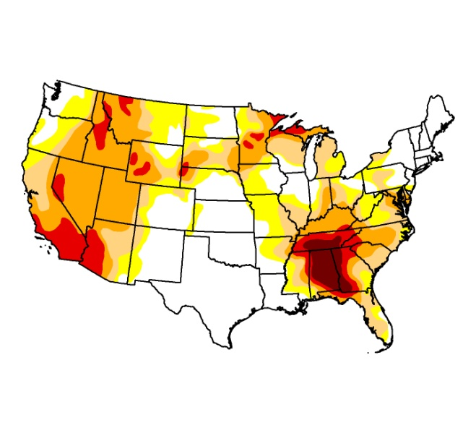
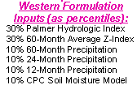

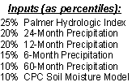
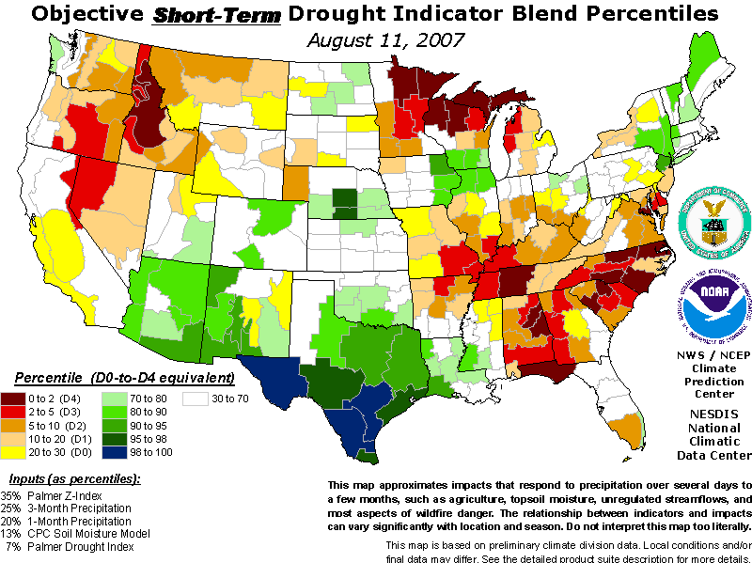
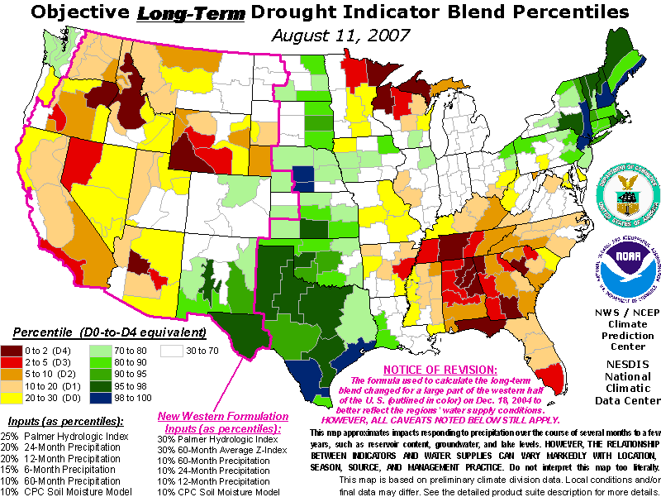
North America:
U.S. and N.A. Drought Monitors
Final U.S. DM product
Subjective input
R. Houborg – NASA / U Maryland
Notes:
These are the primary short and long-term objective Drought Indicators that currently go into the Drought Monitor process. None of the indicators consider groundwater variations and they are all more or less based on precipitation. Important indices include the Palmer drought indices and various standardized precipitation indices to access moisture anomalies on a time-scale of 1 month to timescales greater than 1 year.
It is important to stress that the objective blends do not depict drought conditions as accurately as the final DM product, which also incorporates a great deal of subjective input and assessments such as opinions from experts/specialists working at local and regional levels that may utilize local field observations in their assessments.

Slide 17
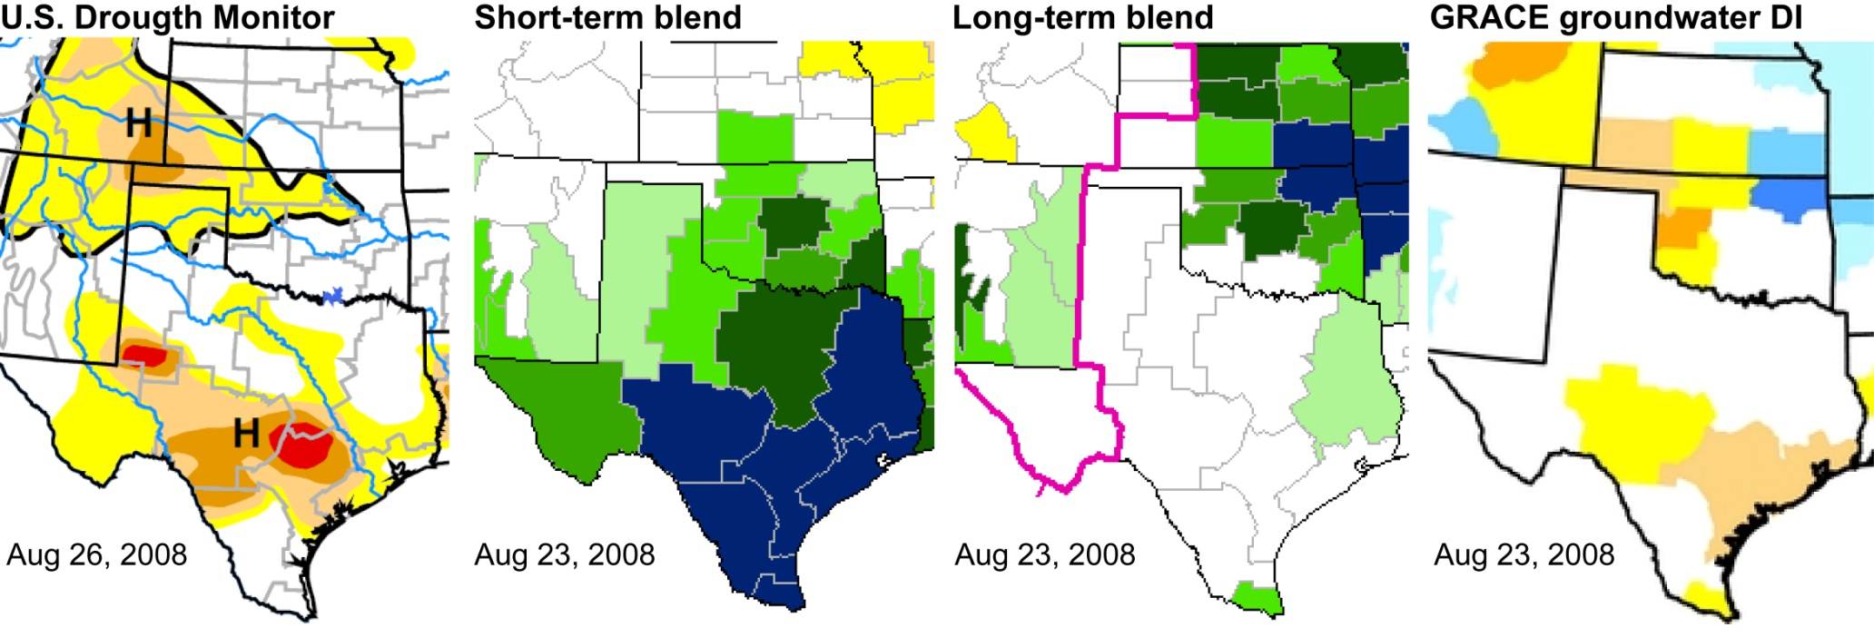
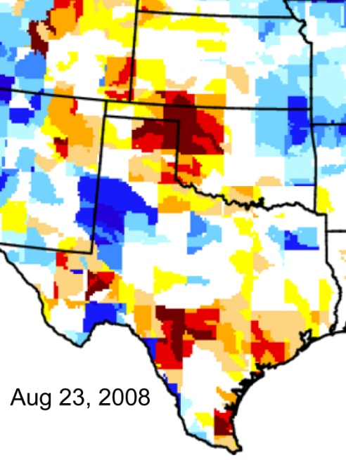
Value of the GRACE for detecting drought
R. Houborg – NASA / U Maryland
Notes:
I showed this in an earlier slide as an example when the current short and long-term objective blends fail at detecting drought conditions. In this case, the GRACE groundwater DI does a much better job at delineating drought prone regions in southern Texas and in the depicted Midwestern states. And this is the finer native resolution map (click)

Slide 18
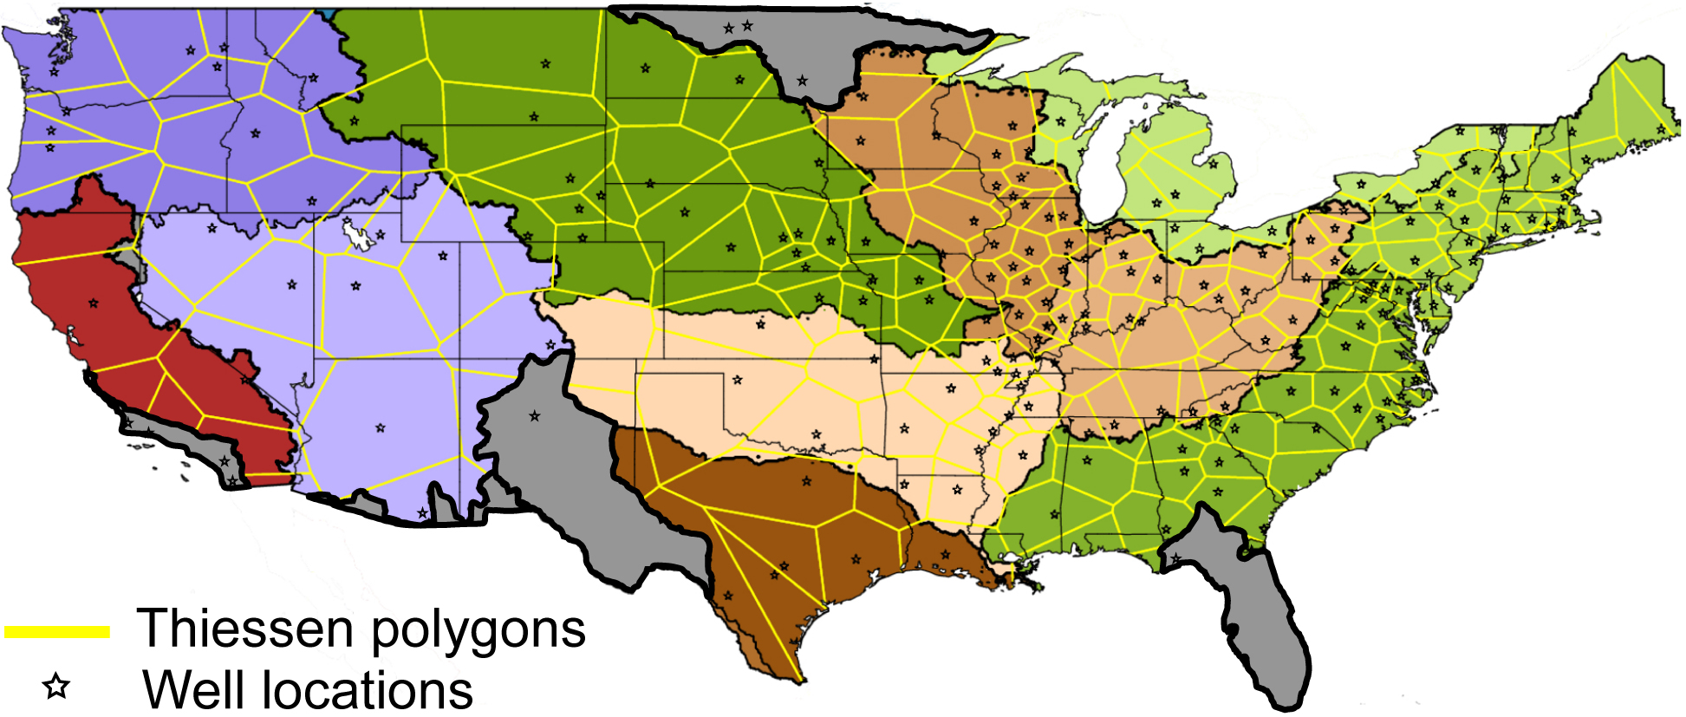
Evaluating groundwater estimates
Groundwater observation network (USGS)

Slide 19
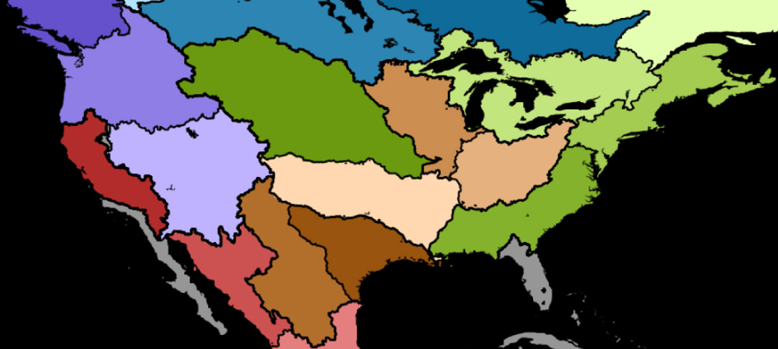
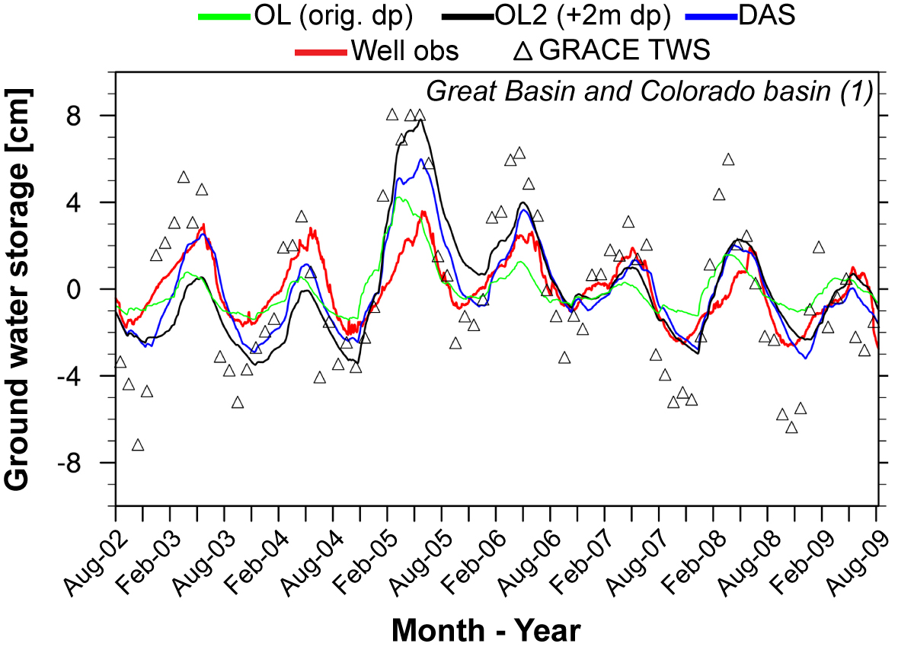
Great Basin and Colorado
GB & CB
OL: r = 0.62
OL2: r = 0.70
DAS: r = 0.83
OL: rms = 1.17
OL2: rms = 1.79
DAS: rms = 1.15
R. Houborg – NASA / U Maryland

Slide 20
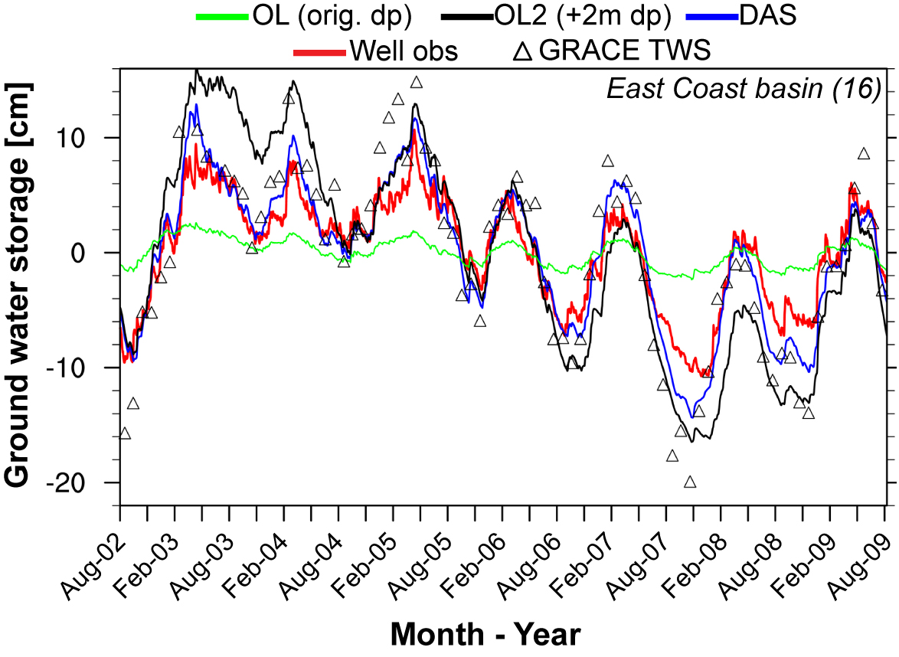
Eastern Basins
EB
OL: r = 0.93
OL2: r = 0.93
DAS: r = 0.97
OL: rms = 3.67
OL2: rms = 4.85
DAS: rms = 2.09
R. Houborg – NASA / U Maryland

Slide 21
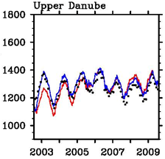
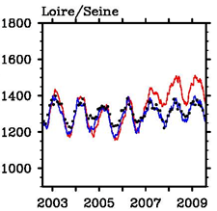
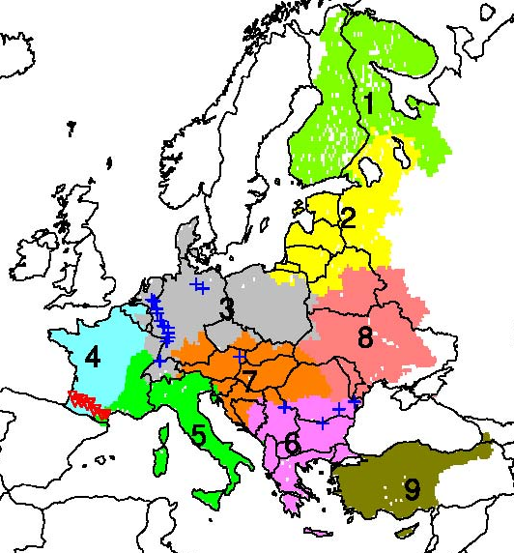
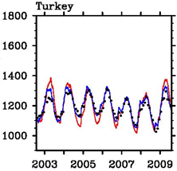
European Simulations
Red = open loop
Black = GRACE
Blue = GRACE-DA
Bailing Li – NASA / SAIC

Slide 22
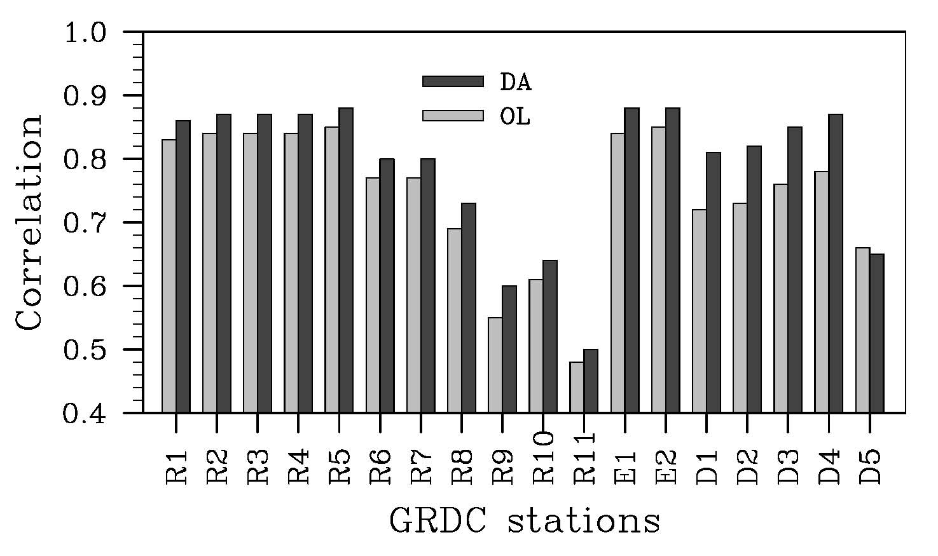
Europe: streamflow
Bailing Li – NASA / SAIC

Slide 23
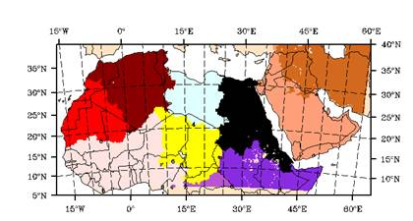
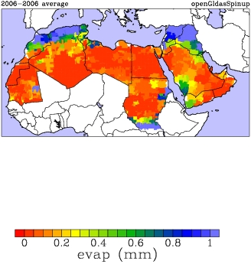
Middle East & North Africa
A collaboration between NASA, USAID and ICBA
Extremely arid conditions
Transboundary aquifers
Significant groundwater extractions
J. Bolten – NASA
ET (mm/day) for April 2006

Slide 24

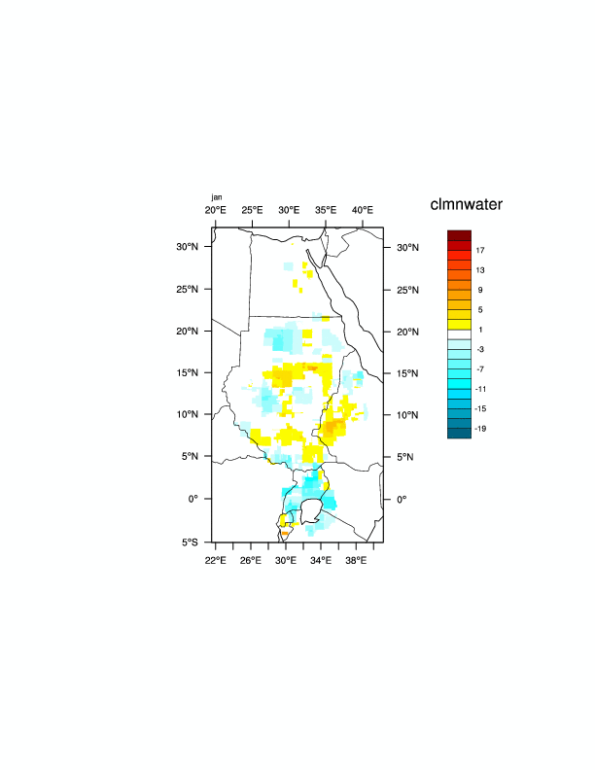
Nile basin
In support of the Nile Land Data Assimilation System (Nile LDAS)
Results show significant impact of GRACE-DA
Evaluation is pending
TWS_{OL} - TWS_{DA}

Slide 25
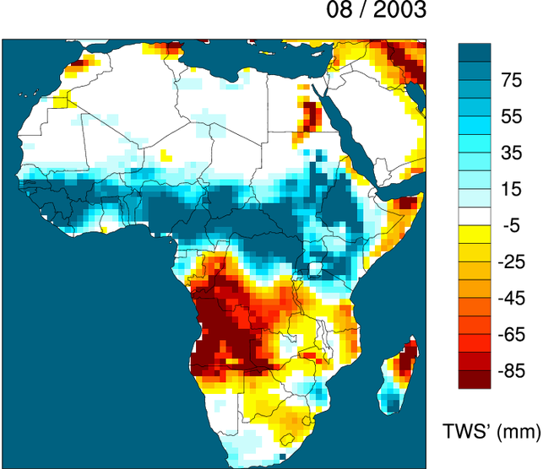
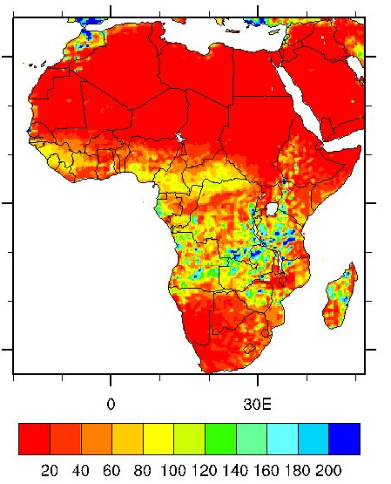
Other African Applications?

Slide 26
Future Directions
Multisensor data assimilation algorithms:
  GRACE + AMSR-E + MODIS
Extend operational drought monitoring applications
Application to regional climate simulation

Slide 27
Questions for GRACE-DA
What is the true relationship between GRACE estimates and hydrological models?
What are the range and limits for GRACE applications to water management?
Can GRACE-DA inform model parameterization? Model development?

Slide 28
Thank you

