Slide 1

AFRICA ARRAY –IGCP 565
WaterNet & Capacity building in water resources Management in Africa
By Jean-Marie Kileshye Onema, PhD
WaterNet is a proposed
SADC subsidiary institution

Slide 2
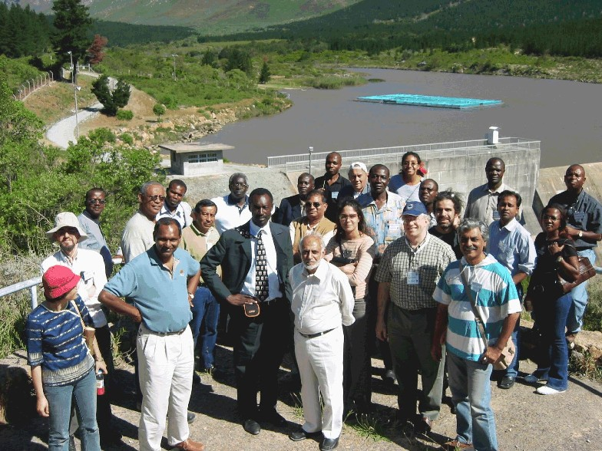
Who are we?
WaterNet is a partnership of training institutions, research institutions, universities & practitioners in the water sector in Southern Africa
We seek to build human & institutional capacity in Integrated Water Resources Management

Slide 3
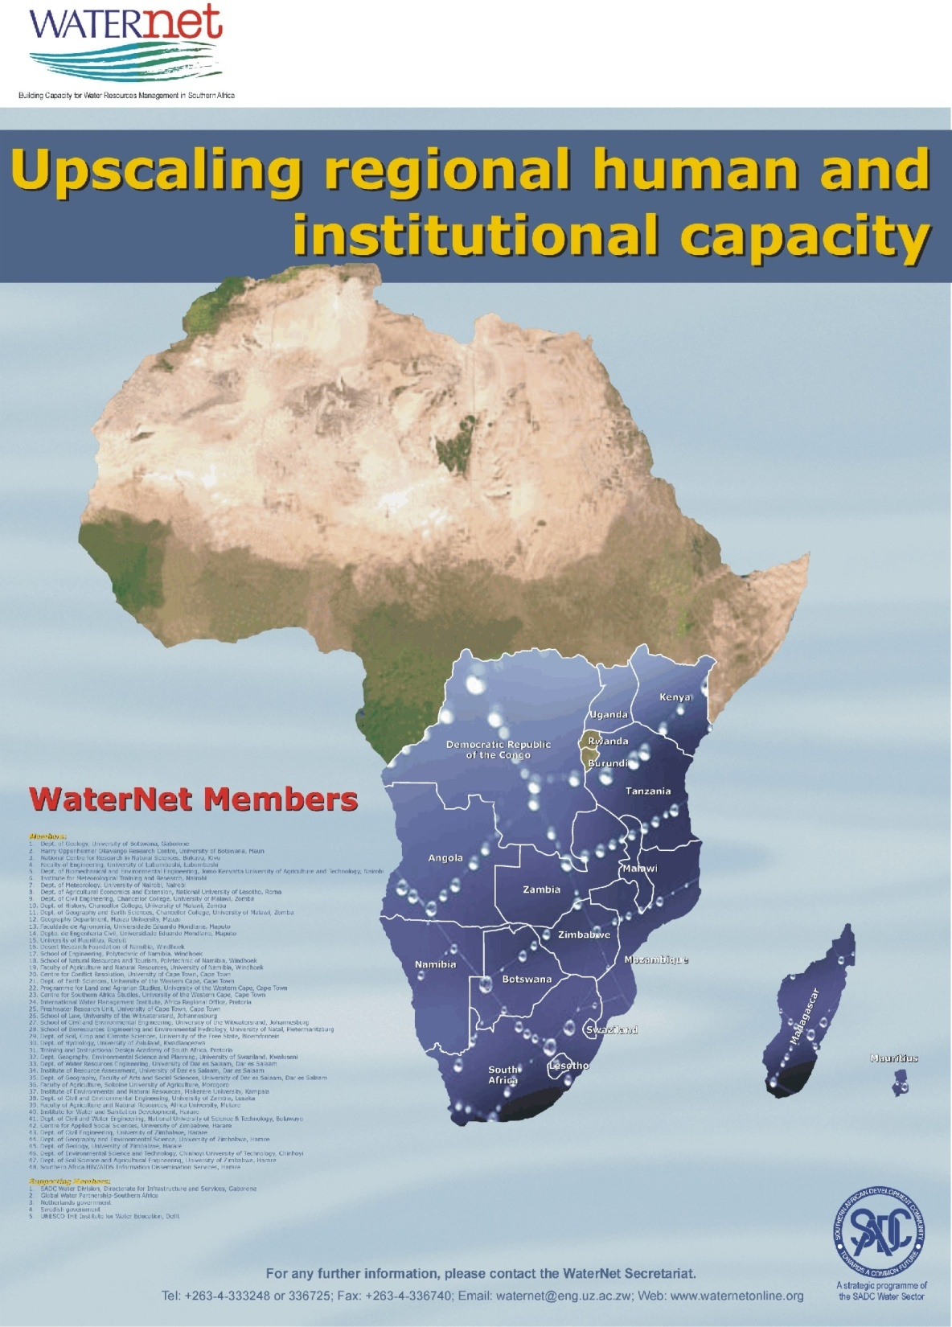
The Network
Capacity building network in IWRM
Founded in 1999
A strategic program of the SADC Water Sector
Links with other networks through affiliation with Cap-Net
72 member institutions from 16 countries in East and Southern Africa

Slide 4
Vision & Mission
“equitable and sustainable utilisation of water for social, environmental justice, economic integration and economic benefit for present and future generations in Southern Africa.”
To enhance regional capacity in Integrated Water Resources Management through training, education, research and outreach by sharing the complementary expertise of members

Slide 5

  Regional Masters Program in IWRM
Hosted by 6 universities since 2002
Guest lecturers drawn from regional & international institutions
Active Alumni Association

Slide 6
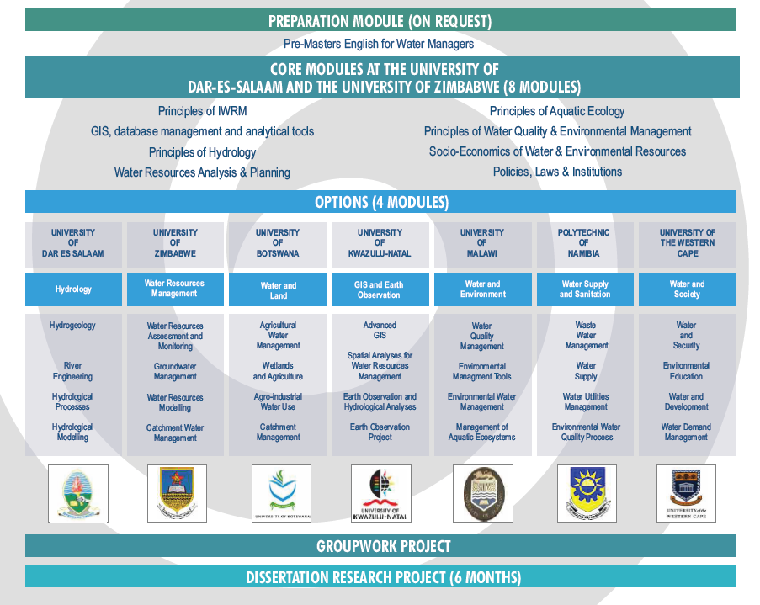
OVER 300 graduates

Slide 7
Waternet Msc Applications 2010
1 out 10

Slide 8
Trainings
WaterNet develops and organizes regional short professional courses that synthesize
Best available research
Local knowledge
On-the-Ground experience
Then, adaptation and replication at local country level is done. To date over 35 courses have been delivered to more than 1000 participants.

Slide 9
Collaborative research
Agricultural land and water management for poverty alleviation
Hydrological processes
Socio-economic aspects of water allocation at river basin scale
Improved Drought Early Warning and Forecasting

Slide 10
Collaborative research
Efficient allocation policies in a dynamic and uncertain hydrologic environment
Balancing ecosystem health with hydropower generation in hydro-power dominated basins
Integration of social and natural systems in enhancing environmental sustainability and
Impact of mining and mineral processing on the environment and human health.

Slide 11
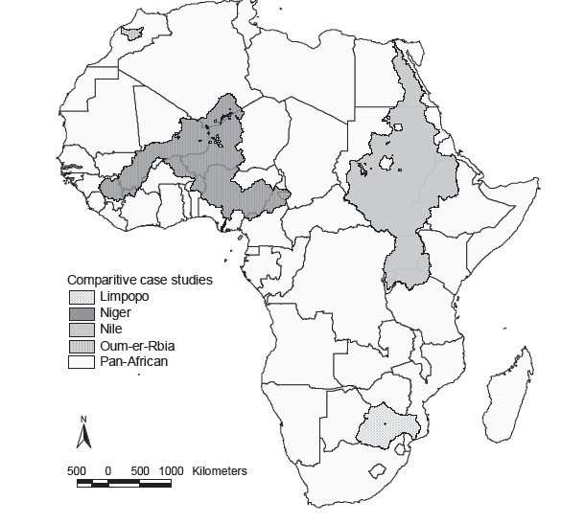
CV
CV

Slide 12
Limpopo BDC
1. Targeting and scaling out—SEI (Wits, WaterNet, IWMI-SA)
2. Small scale infrastructure: how can it sustainably support smallholder farmers—ARC
3. Farm systems and risk management—ICRISAT
4. Governance- WATERNET
5. Coordination & change: learning for innovation and adaptive management—FANRPAN (WaterNet, GWPSA)

Slide 13
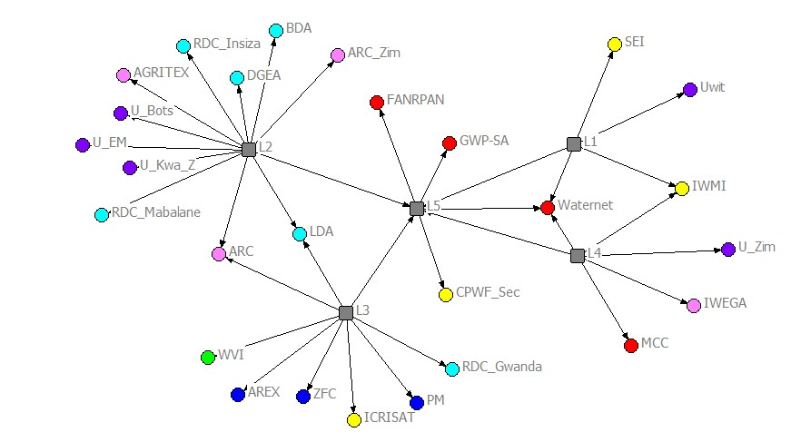
CPWF-Limpopo
 | ARI or CG Center
 | Network or RBO
 | NGO
 | Private Sector
 | GO
 | NARES
 | University

Slide 14
Capacity building-CPWF
Global
Andes
Ganges
Limpopo
Mekong
Nile
Volta
Basin
LM1
LM2
LM3
LM4
LM5
Project

Slide 15
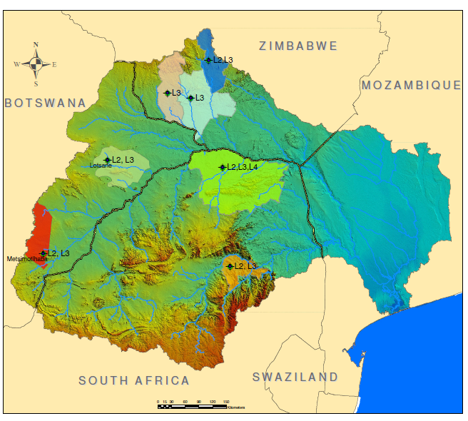

L4: Insiza
L4: Gwanda
L4
Lambani
L2, L4: Mabalane
=
=

Slide 16
New cases- LM1
BW
WaterNet
Coordination
MZ
WaterNet
Coordination
Facilitation
ZW
WaterNet
Coordination
Facilitation
ZA
Wits
Facilitation
Facilitation
Coordination

Slide 17

Approach

Slide 18
Results: Final number of characterised small reservoirs
256 small reservoirs in the district: relatively high number compared to records held by DDF (149), RDC (154),
68% (174) likely to dry up before the next season.
a threshold of 52,222m3 was calculated as the minimum size below which a reservoir is likely to dry up before next rains.
Require catchment protection interventions to ensure sustainability

Slide 19
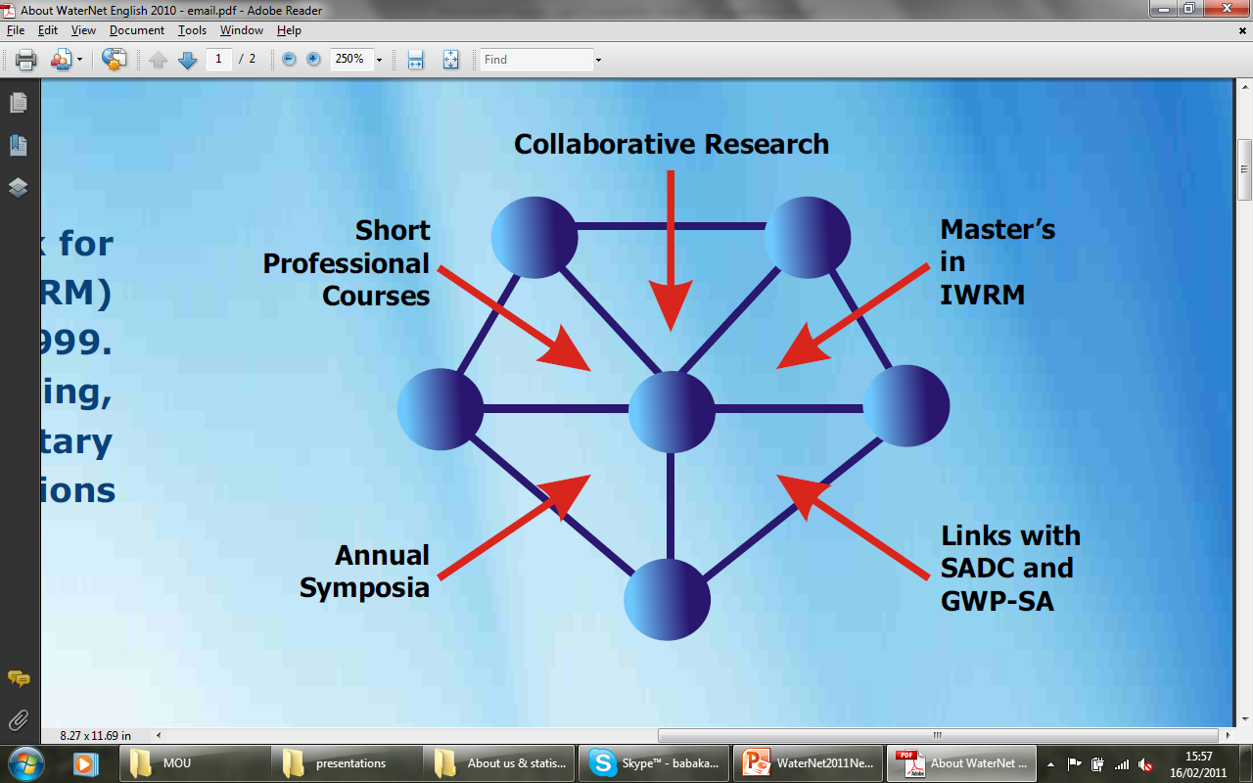

Funded by
CPWF-L5
SADC-EAC
Large water infrastructure
Netherlands Ministry of Development Cooperation
Special Projects (led by Trust or led by members)
Swedish International Development Cooperation Agency (ends 2011)
DEWFORA
Water economics training
IGCP565
Tools for WRM
Southern Africa regional

Slide 20
Conclusion and way forward
Capacity development in Water Resources Management still needed in the SADC region and beyond
Africa array and IGCP 565 to be platform for further collaboration in capacity development in WRM SSN.

Slide 21
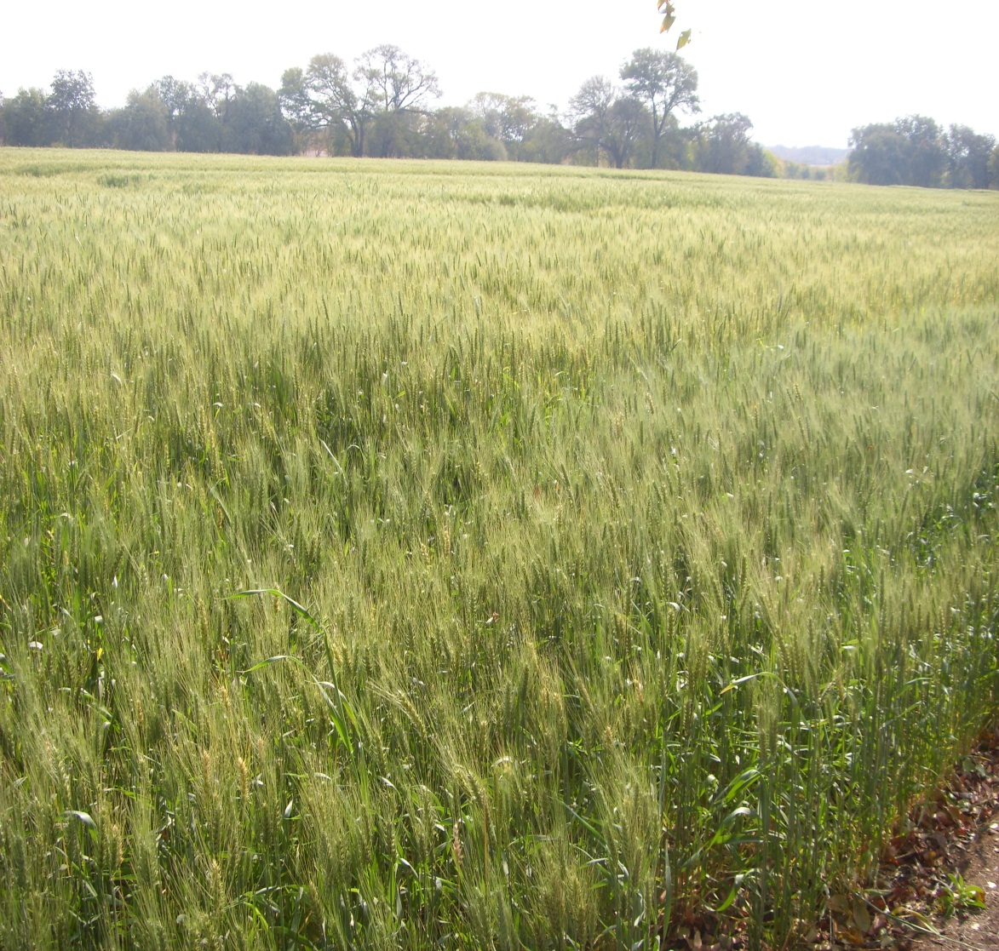
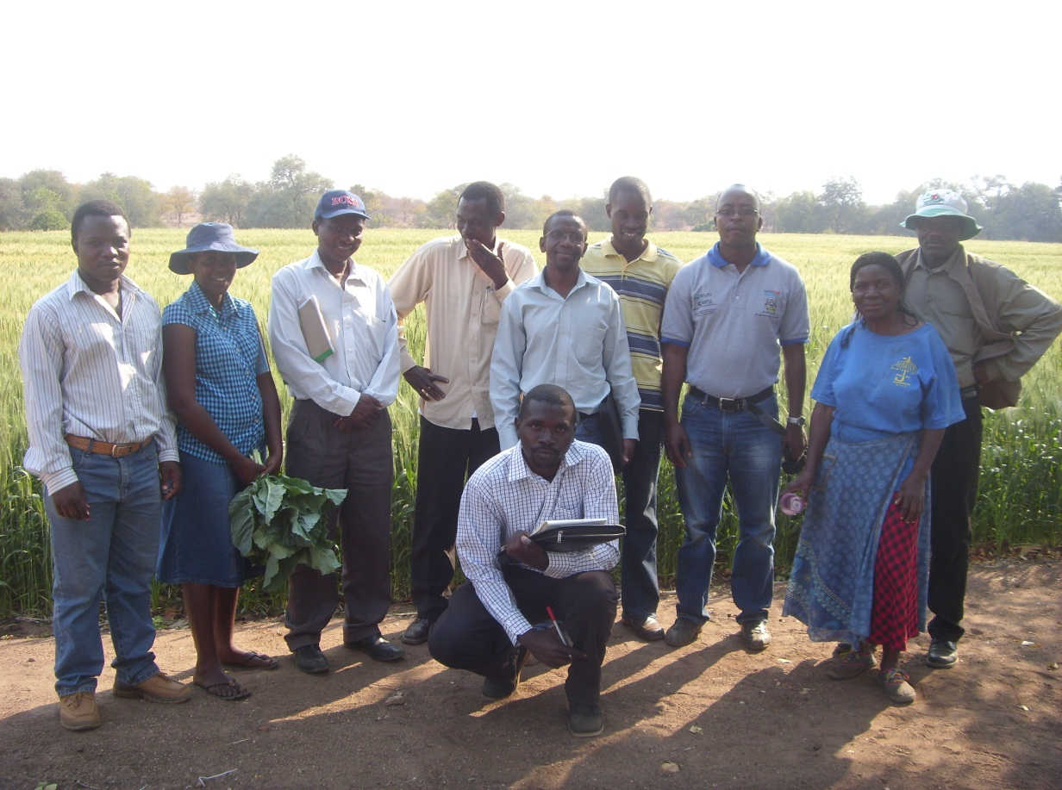
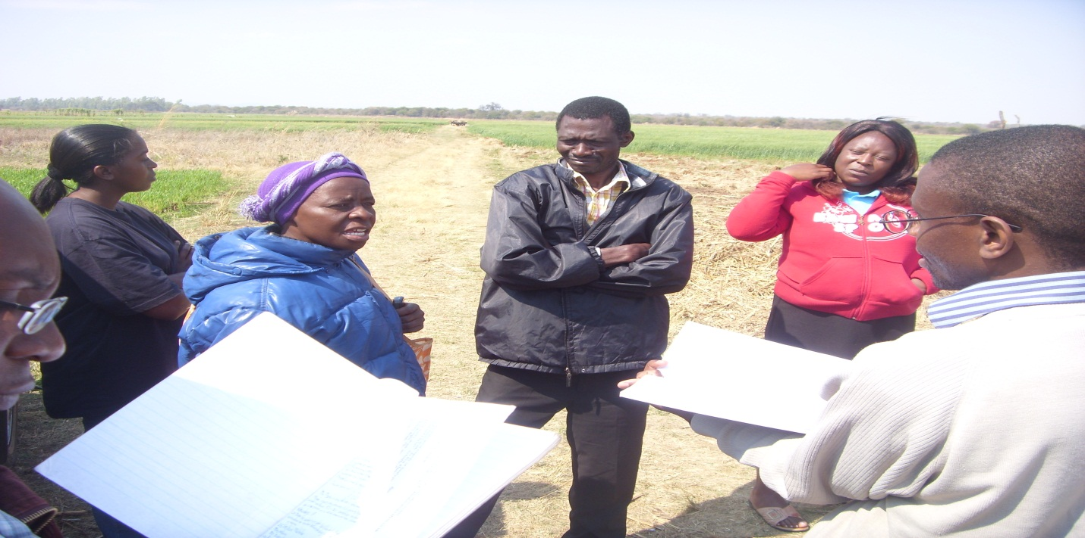
Thank-you

